Slide 1
Artificial Intelligence: Agents, Architecture, and Techniques
Based on the slides from Introduction to Game Development by Scott Rabin

Slide 2
What is Considered Game Artificial Intelligence?
Is it any NPC behavior?
A single “if” statement?
Scripted behavior?
Pathfinding?
Animation selection?
Automatically generated environment?
Best shot at a definition of game AI?
An inclusive definition of game AI:
“Game AI is anything that contributes to the perceived intelligence of an entity, regardless of what’s under the hood.”

Slide 3

Goals of an AI Game Programmer
Game AI is not necessarily academic:
1. AI must be intelligent, yet purposely flawed
2. AI must have no unintended weaknesses
3. AI must perform within the constraints
4. AI must be configurable by game designers or players
5. AI must not keep the game from shipping
Borderlands 3 Class
Flak the Beastmaster is a homeless-looking android. He can summon multiple creatures to help him fight. The AI for this is what delayed announcement last October (2018). Pre-Announce Leak

Slide 4
Game AI Developer Specialization
No one-size fits all solution to game AI
Results in dramatic specialization
Strategy Games
Battlefield analysis
Long term planning and strategy
First-Person Shooter Games
One-on-one tactical analysis
Intelligent movement at footstep level
Real-Time Strategy games are the most demanding, with as many as three full-time AI game programmers

Slide 5
Game Agents
May act as:
Opponent
Ally
Neutral character
Continually loops through the Sense-Think-Act cycle
Optional learning or remembering step

Slide 6
Sense-Think-Act Cycle: Sensing
Agent can have access to perfect information of the game world
May be expensive/difficult to tease out useful info
Game World Information
Complete terrain layout
Location and state of every game object
Location and state of player
But isn’t this cheating???
Can argue that player 'radar' evens the playing field

Slide 7
Sensing: Enforcing Limitations
Human limitations?
Limitations such as
Not knowing about unexplored areas
Not seeing through walls
Not knowing location or state of player
Can only know about things seen, heard, or told about
Must create a sensing model

Slide 8
Sensing: Human Vision Model for Agents
Get a list of all objects or agents; for each:
1. Is it within the viewing distance of the agent?
How far can the agent see?
What does the code look like?
2. Is it within the viewing angle of the agent?
What is the agent’s viewing angle?
What does the code look like?
3. Is it unobscured by the environment?
Most expensive test, so it is purposely last
What does the code look like?
Magnitude of the vector is less than or equal to the maximum viewing distance; use distance squared (not square root).
Dot product between normalized direction vector and vector to the target; compare to agent's viewing angle.
For each 'viewable' object, test against the environment to see if the object is obscured or not.

Slide 9
Sensing: Vision Model
Is vision more than just detecting the existence of objects?
What about recognizing features of a puzzle with a helpful NPC?
If Robin helped Batman in a tandem game.
What about recognizing interesting terrain features?
What would be interesting to an agent?

Slide 10
Sensing: Human Hearing Model
Humans can hear sounds
Can recognize sounds
Knows what emits each sound
Can sense volume
Indicates distance of sound
Can sense pitch
Sounds muffled through walls have more bass
Can sense location
Where sound is coming from
How do you model hearing efficiently?
Do you model how sounds reflect off every surface?
How should an agent know about sounds?
Possible Answers:
Event-based approach
When sound is emitted, it alerts interested agents
Use distance and zones to determine how far sound can travel

Slide 11


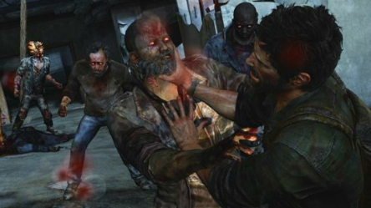

Infected in Last of Us
Infected are humans who have succumbed to a parasitic fungus.
"The Infected are driven by the instincts of the fungus."
Infected rely primarily on hearing.

Slide 12
Sensing: Infected in Last of Us I
The sensory system does not reason about actual game audio.
Instead, logical sounds are used.
Allows designers to have more control about what sounds are heard at what range by each Infected type.
Characters (Joel and Ellie) are animated breathing, but those are not considered logical sounds.
Logical sounds are broadcast over a radius; those within the radius can hear it (sounds are occluded by the environment: walls, etc.).
Rays are cast from each character within the sound radius to the source to determine the level of occlusion.

Slide 13
Sensing: Infected in Last of Us II
Different Infected types hear at different rates.
Player movement:
The broadcast radius of logical movement is scaled based on the speed of the player.
This requires stealth nearby an Infected, but allows faster movement as the player approaches from far away.
When an Infected hears a player, they enter an agitated state informing the player they have been detected.

Slide 14
Sensing: Communication
Agents might talk amongst themselves!
Guards might alert other guards
Agents witness player location and spread the word
Model sensed knowledge through communication
Event-driven when agents within vicinity of each other
The Infected's Agitated State vocalization alerts other infected within radius. (Hard to tell: link)

Slide 15
Sensing: Reaction Times
Agents shouldn’t see, hear, communicate instantaneously
Players notice!
Build in artificial reaction times
Vision: ¼ to ½ second
Hearing: ¼ to ½ second
Communication: > 2 seconds
Assassin's Creed 2: Hay Assassination
Destiny 1: We've Woken the Hive

Slide 16
Sense-Think-Act Cycle: Thinking
Thinking is what people consider to be true AI
Sensed information gathered
Must process sensed information
Two primary methods
Process using pre-coded expert knowledge (if-then encoding of a ruleset) with elements of randomness (to mitigate predictability)
Use search to find an optimal solution

Slide 17
Thinking: Expert Knowledge
Many different systems
Finite-state machines (States encoded and transitions via a switch: e.g, Dungeon Delver movement)
Production systems (similar to a grammar with repeated substitutsions)
Decision trees
Logical inference
Encoding expert knowledge is appealing because it’s relatively easy
Can ask just the right questions
As simple as if-then statements (theoretically)
Problems with expert knowledge
Not very scalable

Slide 18
Thinking: Search
Employs search algorithm to find an optimal or near-optimal solution
Pathfinding common use of search (A*, not Dijkstra)
Consider Uno with a rule modification: play as many cards as possible (chained together) in one turn.
How to identify the optimal play sequence?
More complex with two players (because turns can be sequenced with Skip, Reverse, Draw Two, Draw Four).

Slide 19
Thinking: Machine Learning
If imparting expert knowledge and search are both not reasonable/possible, then machine learning might work
Examples:
Reinforcement learning
Neural networks
Decision tree learning
Not often used by game developers
Why?
Complexity
CPU Requirements
Effect on Development Time
Inexperience of Developers
The technique does not outperform an expert system.

Slide 20
Thinking: Prevent Flip-Flopping Decisions
Must make a decision and stick with it
Until situation changes enough
Until enough time has passed
Reaction times might help keep it from happening every frame
Flip-flopping must be guarded against: imagine an AI switching tasks every 0.5 seconds.

Slide 21
Sense-Think-Act Cycle: Acting
Sensing and thinking are steps invisible to player
Acting is how a player witnesses intelligence
Numerous agent actions, for example:
Change locations
Pick up object
Play animation
Play sound effect
Converse with player
Fire weapon

Slide 22
Acting: Showing Intelligence
Adeptness and subtlety of actions impact perceived level of intelligence
Agent can only express intelligence in terms of vocabulary of actions
Enormous burden on asset generation
Must use scalable solutions to make selections

Slide 23
Extra Step: Learning and Remembering
Optional last step in Sense-Think-Act Cycle
Not necessary in many games
Agents do not live long enough
Game design might not desire it
Imagine Punch-Out! where enemies change mid-match to counteract player actions.
Learning
Remembering outcomes and generalizing to future situations
Simplest approach: gather statistics
If 80% of time player attacks from left
Then expect this likely event
Adapts to player behavior
Remembering
Remember hard facts
Observed states, objects, or players
For example
Where was the player last seen?
What weapon did the player have?
Where did I last see a health pack?
Memories should fade
Helps keep memory requirements lower
Simulates poor, imprecise, selective human memory

Slide 24
Remembering Within the World
All memory doesn’t need to be stored in the agent
If many agents, the same knowledge might be stored twice: waste of resources
Memories stored in the world
Agents get slaughtered in a certain area
Area might begin to “smell of death”
Agent’s path planning will avoid the area
Simulates group memory
Assassin's Creed
Enemies remember last position where you are seen.
Memoryless NPCs with deaths:
Can lure any number of NPCs to a haystack,
When you have successfully hidden, NPCs sometimes ignore dead bodies on the ground.
Non-combative enemies ignore deaths.
AC Unity

Slide 25
Making Agents Stupid
Sometimes very easy to trounce player
Make agents faster, stronger, more accurate
Sometimes necessary to dumb down agents, for example:
Make shooting less accurate
Make longer reaction times
Engage player only one at a time (Batman Fight)
Change locations to make self more vulnerable
Players don’t like agent cheating
When agent given unfair advantage in speed, strength, or knowledge
Sometimes necessary (or designed that way: Dark Souls)
For highest difficultly levels
For CPU computation reasons
For development time reasons
Don’t let the player catch you cheating!
Consider letting the player know upfront

Slide 26
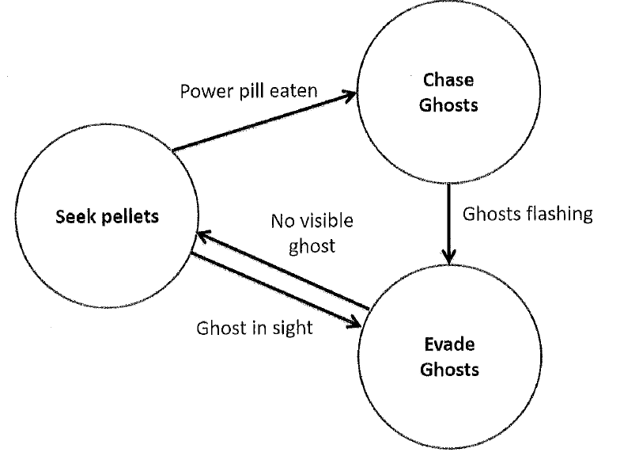
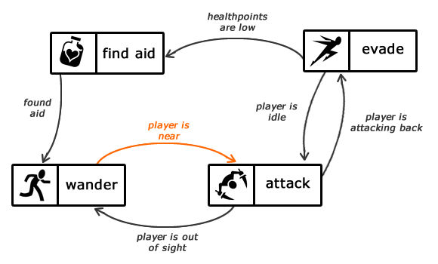
Finite-State Machines (FSMs)
Abstract model of computation
Informally:
Set of states
A starting state
An input vocabulary
A transition function that maps inputs and the current state to a next state
In a game sense, we do not always have a set of accepting states (death might be).

Slide 27
Finite-State Machines
Most common game AI software pattern
Natural correspondence between states and behaviors
Easy to diagram
Easy to program
Easy to debug
General to any problem
Problems
Explosion of states
Often created with ad hoc structure
Are not capable of:
Pathfinding
Reasoning
Learning

Slide 28
Sample Finite-State Machine
Three Implementation Approaches
Hardcoded (switch statement)
Scripted
Hybrid Approach
'Scriptable' FSM with the Delegate Design Pattern

Slide 29
FSM Implementation: Hardcoded
void RunLogic( int * state )
{
switch( state )
{
case 0: // Wander
Wander();
if( SeeEnemy() ) { *state = 1; }
break;
case 1: // Attack
Attack();
if( LowOnHealth() ) { *state = 2; }
if( NoEnemy() ) { *state = 0; }
break;
case 2: // Flee
Flee();
if( NoEnemy() ) { *state = 0; }
break;
}
}
Problems with Hardcoding
1. Code is ad hoc
Programming language doesn’t enforce structure
2. Transitions result from polling
Inefficient – event-driven sometimes better
3. First time entering a state is a special case
For example, attacking may require a pre-attack state ( unsheathing a sword)
4. Can’t be edited or specified by game designers or players

Slide 30
(Scripted) Finite-State Machine
AgentFSM
{
State( STATE_Wander )
OnUpdate
Execute( Wander )
if( SeeEnemy ) SetState( STATE_Attack )
OnEvent( AttackedByEnemy )
SetState( Attack )
State( STATE_Attack )
OnEnter
Execute( PrepareWeapon )
OnUpdate
Execute( Attack )
if( LowOnHealth ) SetState( STATE_Flee )
if( NoEnemy ) SetState( STATE_Wander )
OnExit
Execute( StoreWeapon )
State( STATE_Flee )
OnUpdate
Execute( Flee )
if( NoEnemy ) SetState( STATE_Wander )
}
Advantages of Scripting
Enforced structure
Events can be handed as well as polling
OnEnter and OnExit concept exists
Can be authored by game designers
Easier learning curve than straight C/C++
Disadvantages of Scripting
Not trivial to implement
Several months of development
Custom compiler
With good compile-time error feedback
Bytecode interpreter
With good debugging hooks and support
Scripting languages often disliked by users
Can never approach polish and robustness of commercial compilers/debuggers

Slide 31
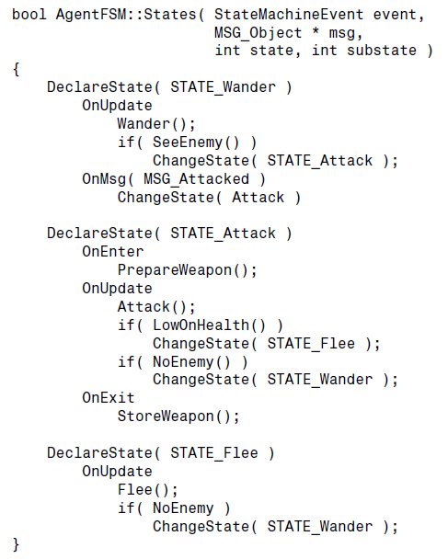
Finite-State Machine: Hybrid Approach
Use a class and C-style macros to approximate a scripting language
Allows FSM to be written completely in C++ leveraging existing compiler/debugger
Capture important features/extensions
OnEnter, OnExit
Timers
Handle events
Consistent regulated structure
Ability to log history
Modular, flexible, stack-based
Multiple FSMs, Concurrent FSMs
Can’t be edited by designers or players

Slide 32
Extensions to Finite-State Machine
Many possible extensions to basic FSM
OnEnter, OnExit (event-driven processing)
Timers
Global state, substates (a state contains a sub-FSM: pre-cursor to Behavior Trees)
Stack-Based (states or entire FSMs)
Allows an NPC to pick up where it left (before it was interrupted).
Multiple concurrent FSMs (Brain FSM and Movement FSM)
High-level deals with goal seeking and goal development
Low-Level deals with rudimentary decisions (obstacle avoidance, etc.)
Debugging may need to be built in: show states above NPCs

